Slide 1
Metasploit Lab on DVWA
Ethical Hacking & Penetration Testing
DVWA Vulnerability Assessment
& DistCC Remote Code Execution using Metasploit
BY RIDHI JAIN

Slide 2
Project Overview
Project Scope
What Was Demonstrated
A controlled Docker-based security lab using DVWA, Kali Linux and Metasploit, with a deliberately vulnerable Metasploitable2 target.
Multiple web-application vulnerability classes were tested, followed by validation of the DistCC command-execution weakness.
Evidence
Key Result
Practical screenshots, Docker/network verification, vulnerability checks and a successfully established command-shell session.
Metasploit confirmed DistCC as vulnerable and the reverse Perl payload opened a shell running in the daemon context.
2

Slide 3
Objectives
Set up and verify an isolated Docker-based cybersecurity laboratory.
Configure and test DVWA vulnerability modules in a controlled environment.
Capture evidence of vulnerable behavior and security-test results.
Identify and validate the DistCC command-execution weakness on Metasploitable2.
Use Metasploit to establish and verify a controlled command-shell session.
Document findings, challenges, learning outcomes and security implications.
3

Slide 4
Tools & Laboratory Environment
Kali Linux
Docker
Command-line security testing and enumeration
Isolated container-based lab
DVWA
MariaDB
Deliberately vulnerable web application
DVWA database backend
Metasploit Framework
Metasploitable2
Vulnerability validation and controlled exploitation
Deliberately vulnerable target
Nmap / Netcat / curl
Enumeration, connectivity and HTTP inspection
4

Slide 5
Lab Architecture & Network
Kali Linux
Metasploit Container
Metasploitable2
Security testing workstation Browser + Nmap + curl
172.19.0.3 Listener: TCP 4444
172.19.0.2 DistCC: TCP 3632
Docker bridge network: msf-lab • Target and Metasploit containers verified on the same network
5

Slide 6
DVWA Security Testing Methodology
1
Initialize DVWA
2
Review modules
3
Injection testing
Database setup and local login workflow
Identify intentionally vulnerable interfaces
Command Injection, SQL Injection and Blind SQLi
4
Client-side testing
5
File/session testing
6
Access/control testing
Reflected, Stored and DOM XSS; JavaScript; CSP
File Inclusion, File Upload and Weak Session IDs
Open Redirect, Cryptography and Authorisation Bypass
6

Slide 7
DVWA Findings
Command Injection
File Inclusion
High • Controlled input produced command-execution evidence.
High • The vulnerable parameter exposed /etc/passwd content.
SQL Injection
Cross-Site Scripting
High • A tautology-style input returned multiple database records.
High • Reflected, Stored and DOM XSS behaviors were demonstrated.
File Upload
Weak Session IDs
High • A file was accepted into the vulnerable upload directory.
Medium • Session identifiers and cookie values were observed.
Open Redirect
Authorisation Bypass
Medium • The vulnerable interface redirected the browser.
High • User-management functionality allowed a successful save operation.
7

Slide 8
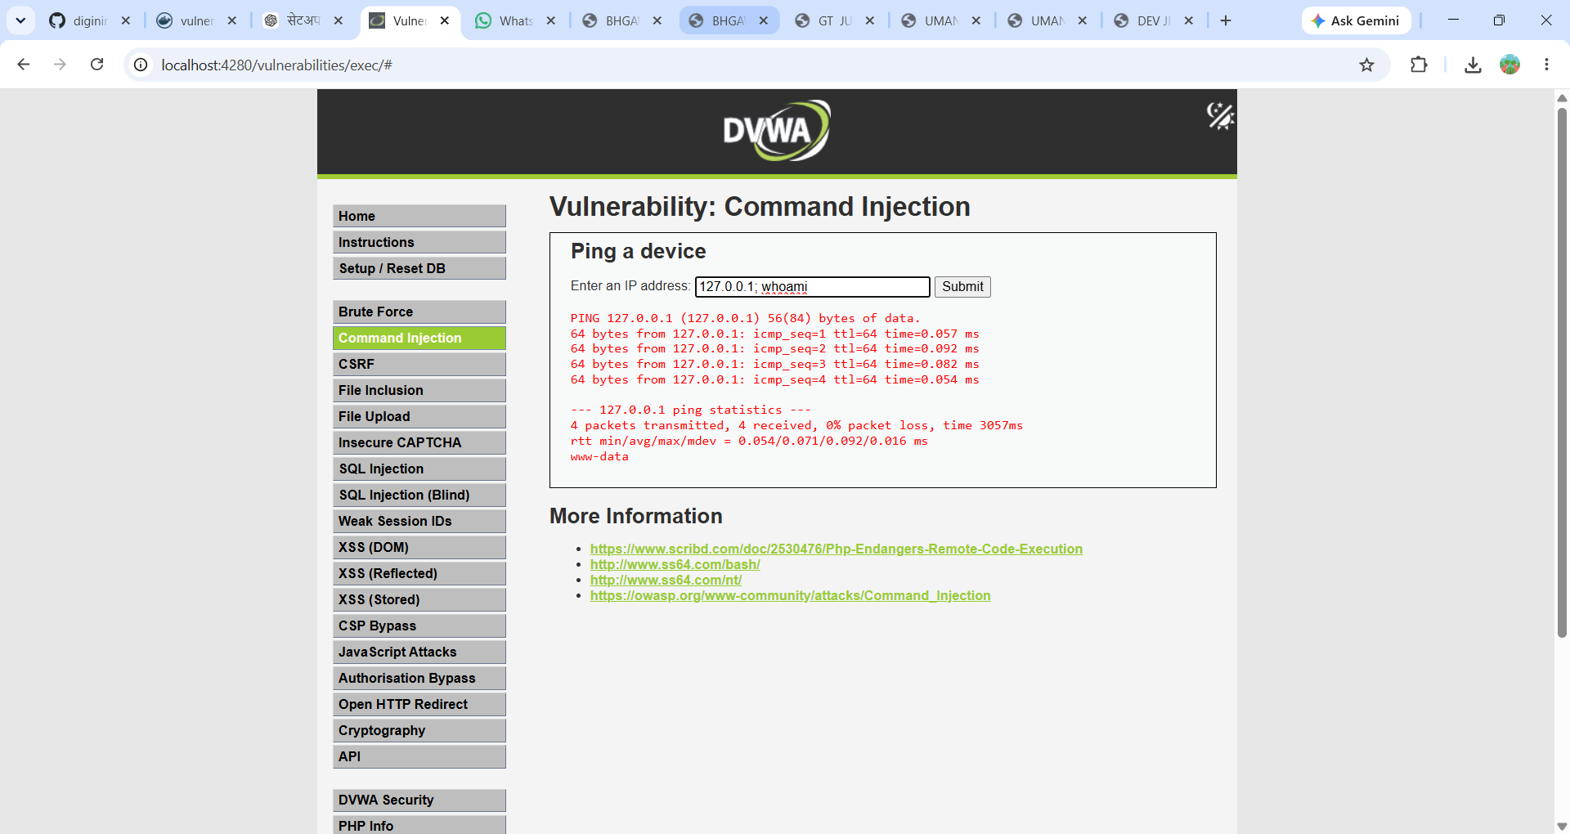
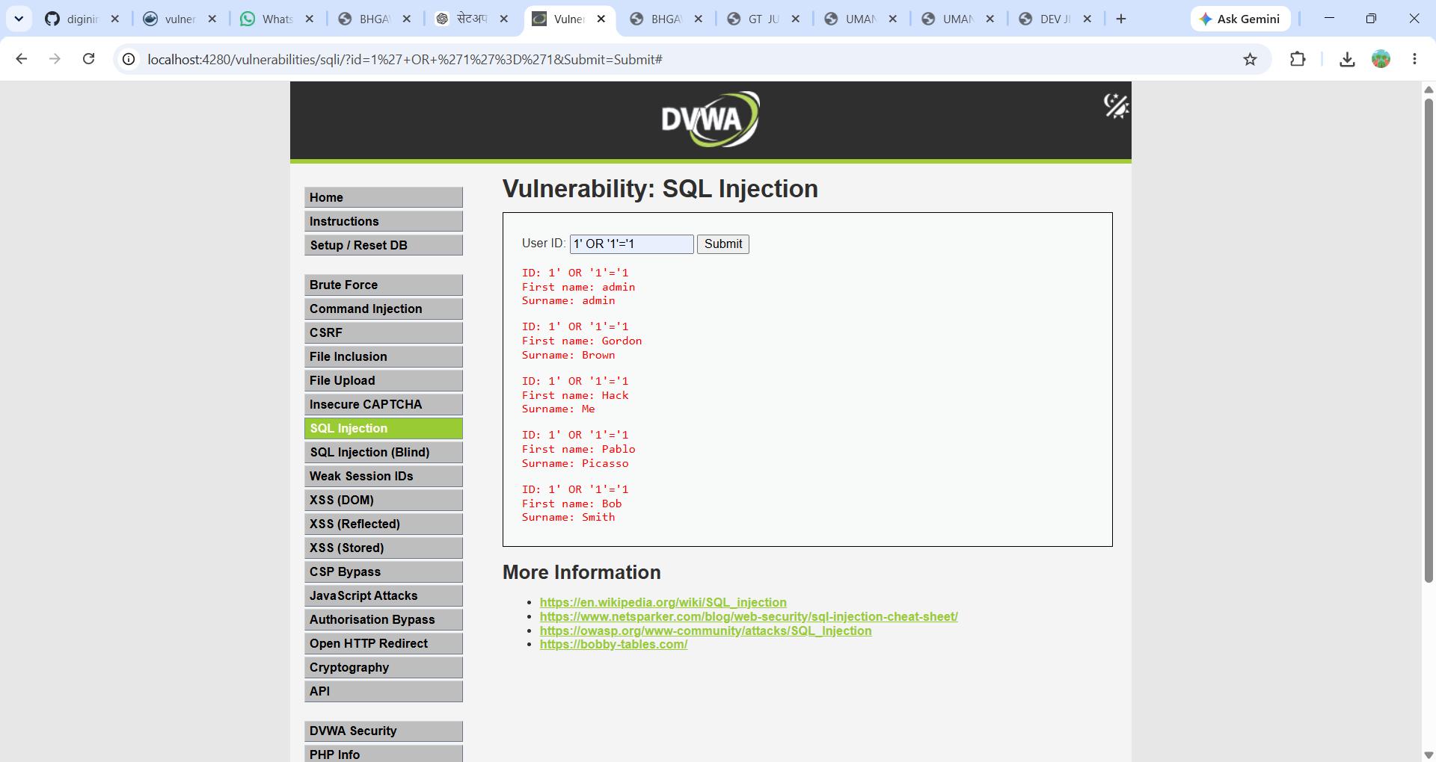
DVWA Practical Evidence
Command Injection — controlled input produced command execution evidence
SQL Injection — tautology-style input returned multiple records
8

Slide 9
Metasploit / DistCC Validation
Target
Metasploitable2 — 172.19.0.2
Service
DistCC — TCP 3632
Module
exploit/unix/misc/distcc_exec
Payload
cmd/unix/reverse_perl
Listener
172.19.0.3:4444
Verification
check → run → sessions -i 1 → whoami / id / hostname
9

Slide 10
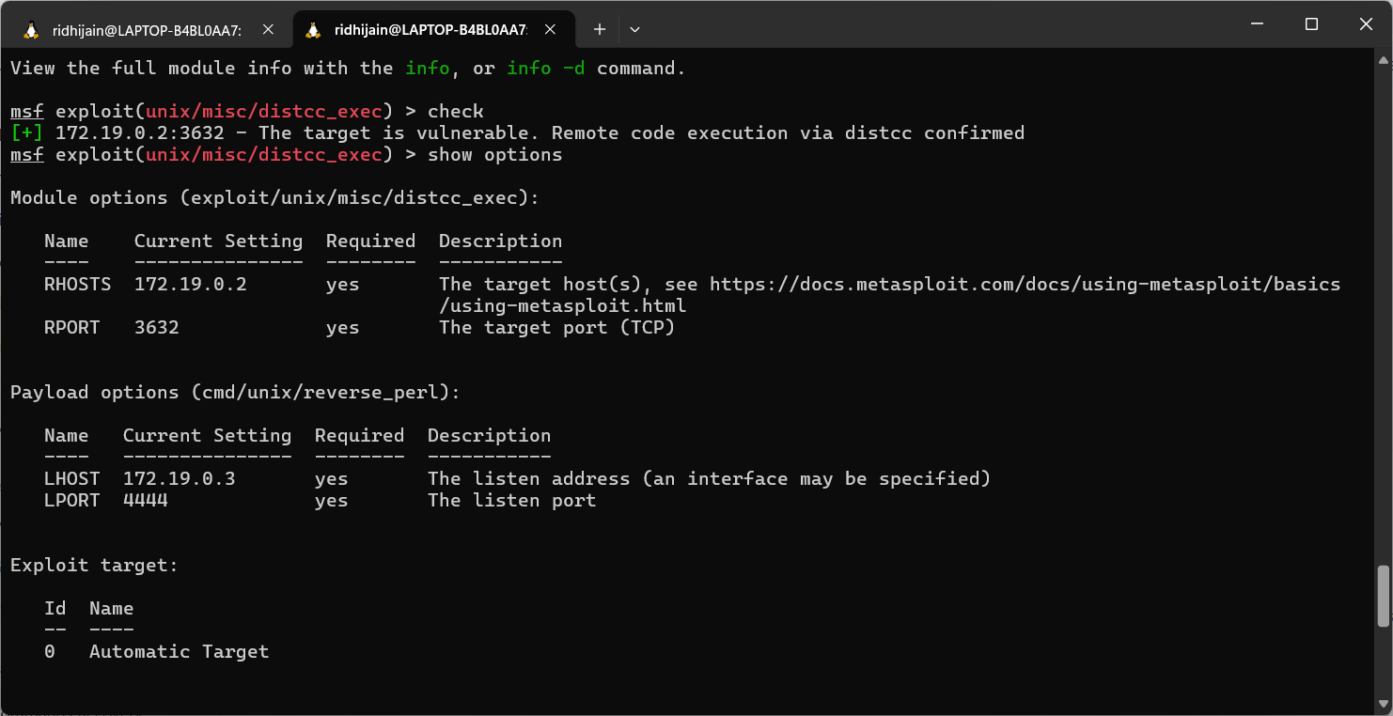
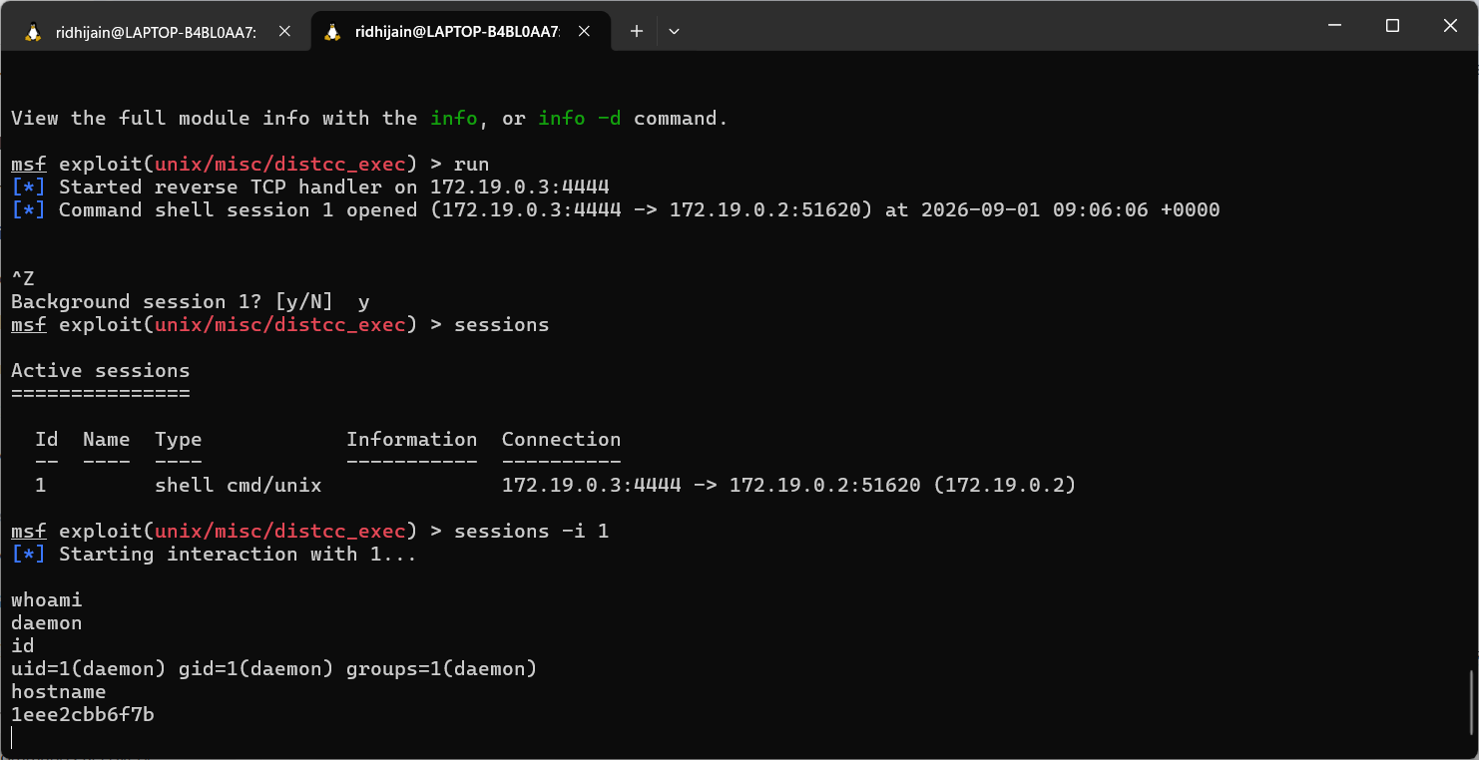
Metasploit Practical Evidence
DistCC vulnerability confirmed; reverse Perl payload configured
Command-shell session established and verified with whoami, id and hostname
10

Slide 11
Results & Observations
DVWA Assessment
DistCC Validation
Multiple intentionally vulnerable web-application classes were reproduced and documented with practical evidence.
Metasploit confirmed remote code execution through the exposed DistCC service on TCP 3632.
Shell Context
Overall Outcome
The successful shell ran as uid=1 (daemon), confirming code execution without root privileges.
The complete exercise was performed in an isolated laboratory environment using Docker containers.
11

Slide 12
Challenges & Learning Outcomes
Key Challenges
How They Were Resolved
• DVWA login initially showed a CSRF token error. • Initial reverse_bash payload did not create a usable session. • Metasploit shell interaction required backgrounding and re-entering the session. • Multiple containers/terminals required explicit network verification.
• Rechecked the DVWA setup/login workflow. • Selected the compatible reverse_perl payload. • Used sessions -i 1 for interaction. • Verified container IPs and TCP 3632 connectivity with Netcat.
Learning Outcome
Hands-on experience with vulnerable web applications, evidence collection, Docker networking, service enumeration, Metasploit module configuration, payload selection and command-shell verification.
12

Slide 13
Conclusion & References
Conclusion
The project successfully completed a hands-on DVWA assessment and a controlled DistCC remote-code-execution demonstration. The DistCC vulnerability was confirmed and a reverse Perl command-shell session was established and verified.
Future Scope
References
• Severity scoring and remediation verification • Automated web scanning • Defensive logging and detection • Retesting after secure configuration • Comparison of additional payloads
• Metasploit Framework Documentation • NVD — CVE-2004-2687 • DistCC Security Information • OWASP XSS / Blind SQL Injection • DVWA — Damn Vulnerable Web Application
13

Slide 14


